Slide 1
Recursion
Lab # 6

Slide 2
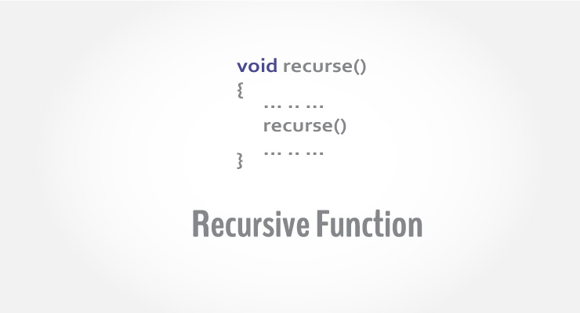
Recursion
The process in which a function calls itself is known as recursion and the corresponding function is called the recursive function

Slide 3
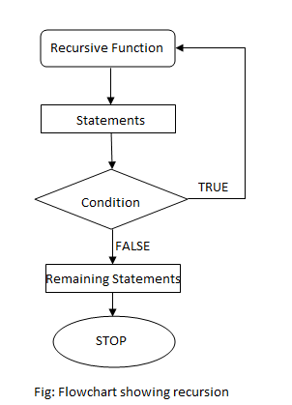
Flow chart

Slide 4
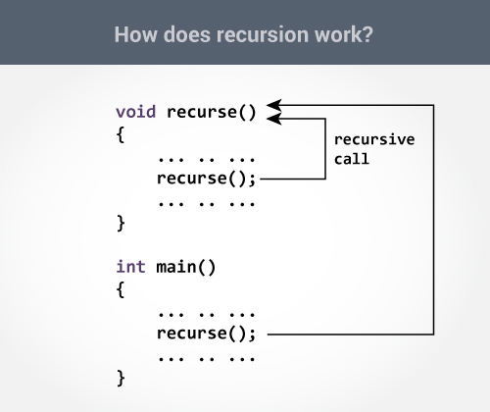

Slide 5
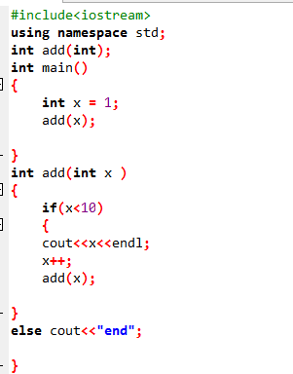

example

Slide 6
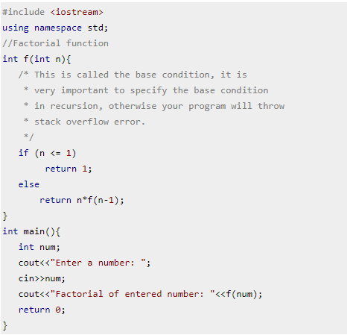
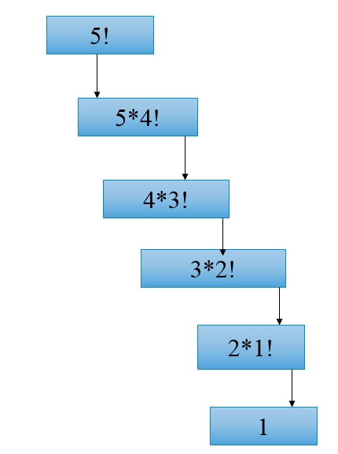

Slide 7
Tower of Hanoi
The Tower of Hanoi is a mathematical game or puzzle. It consists of three rods/pegs, and a number of disks of different sizes which can slide onto any rod. The puzzle starts with the disks in a neat stack in ascending order of size on one rod, the smallest at the top.
The objective of the puzzle is to move the entire stack to another rod in such away they are in same order, obeying the following rules:
Only one disk may be moved at a time
Each move consists of taking the upper disk from one of the rods and sliding it onto another rod, on top of the other disks that may already be present on that rod.
We cannot place a bigger disk on the top of a smaller disk.

Slide 8
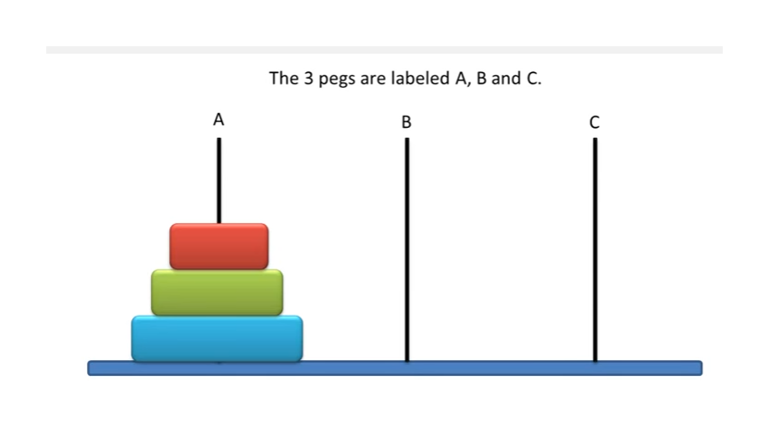

Slide 9
General Notation
T (N, Beg, Aux, End)
Where T donates procedure
N donates the number of disks
Beg is initial peg
Aux is the Auxiliary peg
End is the final peg

Slide 10
Steps
T (N-1, Beg, End, Aux)
T (1, Beg, Aux, End)
T (N-1, Aux, Beg, End)
Step 1 says: Move Top (N-1) disk from beg to Aux peg.
Step 2 Say: Move one disk from Beg to End Peg
Step 3 says: Move Top(N-1) disk from Aux to End.

Slide 11
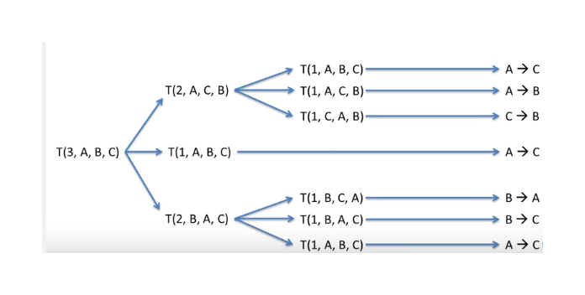
We have three disks all placed in peg A, So N=3 (Number of disk) therefore we start with
T (3, A, B, C)

Slide 12
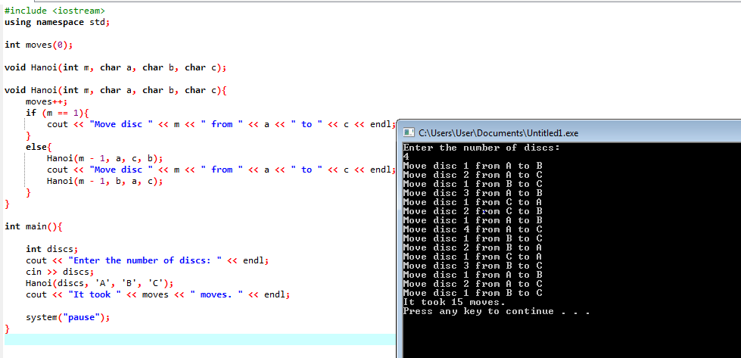
CODE

Slide 13
LAB TASK
Write a program to calculate factorial of any given number by using recursion.
Write a program to calculate the Fibonacci series of any given number using recursion.
Implementation of Tower of Hanoi problem using recursion.

